Slide 1



Volunteer finder
Supervisor: Viktor Kulikov
Students: Feras Kanaan , Muhammad Awawdih

Slide 2

Introduction
Our goal is to build an android application which will make it easier to mange volunteering activities , for the volunteers and for the activity admins .

Slide 3
Motivation
Motivation
Timeserving (use your free time with something).
Help people and do good to the community .
Make it easy to find a specific volunteering activity .
Make it easier to find volunteers for your activity .
Encourage people to volunteer in their time.

Slide 4

Application features
Sign up
Sign up for the application using google account or personal email.
Log in and off
Log in and off from the application .
Join , Add and edit
Users can join and existing activity .
Browse & search & sort
Users can find volunteering activity depending on their:
location, Age, Gender, Expected time/effort or Category
Notifications
Receive and view notifications for changed activity status
User can add and edit volunteering activities requests.
Notes:
Browse and search:
the information about user’s gender and skills(category) are filled by the user in his profile page and synced to the Firestore database.

Slide 5
DEMO

Slide 6
Frame works and libraries
We used Kotlin as programing language.
We used Android Studio software to edit and build the application.
We build our user data base using FireBase(firestore,storage,auth).
We used Google maps for location
We used Google auth library to authenticate google accounts
Glide, espresso and Picasso for images
Android libraries: core, app compat, material, constraint layout, lifecycle and navigation to enable standard layout and in app actions manipulations.

Slide 7
Kotlin
Kotlin is a modern statically typed programming language.
Kotlin coroutines streamline asynchronous programming, making common tasks like network calls and database updates simple and performant.
Safer code : Kotlin helps you avoid Null Pointer Exceptions(With nullability included in its type system), Kotlin’s modern features helps the programmer write less yet expressive code that leads for a few bugs.
Android’s modern UI toolkit is built on Kotlin.
Notes:
Statically typed :- In statically typed programming languages, type checking occurs at compile time .
streamline asynchronous programming: no need to check availability for firebase when we use it (addOnSuccessListener).

Slide 8
Activities and fragments:
Activity | Fragment
Activity is an application component that gives a user interface where the user can interact. | The fragment is only part of an activity, it basically contributes its UI to that activity.
Activity is not dependent on fragment | Fragment is dependent on activity. It can’t exist independently.
we need to mention all activity it in the manifest.xml file | Fragment is not required to mention in the manifest file
We can’t create multi-screen UI without using fragment in an activity, | After using multiple fragments in a single activity, we can create a multi-screen UI.
Activity can exist without a Fragment | Fragment cannot be used without an Activity.

Slide 9
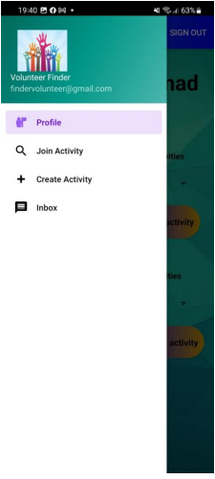
User menu
User menu is the primary activity in our application(after the user is signed in) it manages all the fragments(sub activities) .
The menu contains an app bar and navigation menu
The app bar menu has the sign out button .
The navigation menu is the host for 4 fragments shown in the left picture and is responsible for managing them.
Why use fragments?
When Using fragments in the project, the project structure will be good, and we can handle it easily.
Lifecycle methods in fragments are hosted by hosting activity not OS .

Slide 10
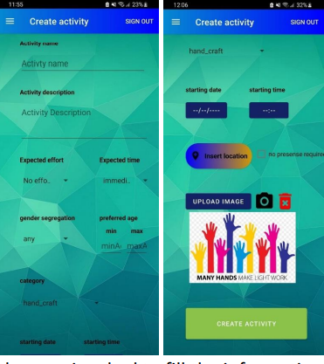
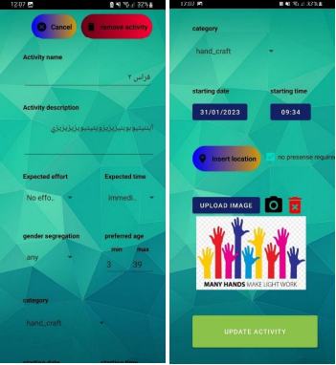
Reusing create activity fragment
Instead of creating a new fragment for editing an existing activity , we decided to reuse the same fragment that is responsible for creating a new activity .
When the fragment is loaded, we check if an activity id was passed by the communicator , in that case we modify the layout and fill it with that activity information .
create
edit

Slide 11
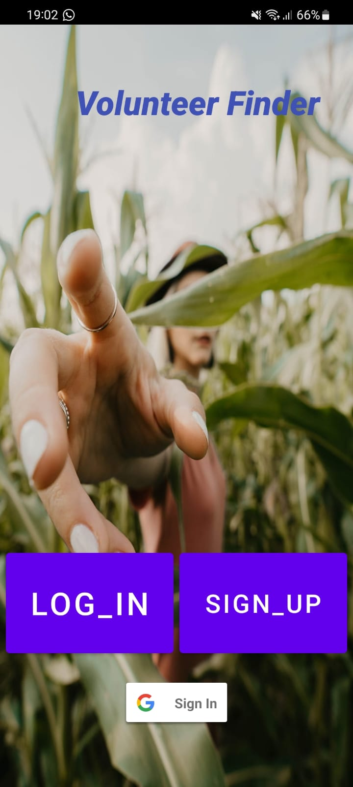
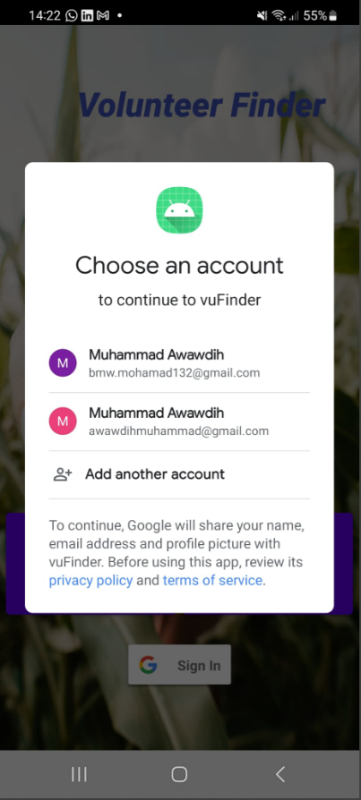
Google sign in
configure Google Sign-In and add a button to your app's layout that starts the sign-in flow.
Google auth (for logging in user ) :- authenticate the user in front of google .
Main activity
Google auth
Check if new user
Get the google sign in client instance .
Get the google id for the client and check if the google user id exist in the fire store.
Get the name and email of user .
Problem: to complete the sign up process we need the user date of birth and the phone number.
Note : the id of google accounts and fire base can not collide , because google id has only numbers , and firebase auto id contains at least one letter.
Notes:
Google don’t allow to give the information of date of birth and phone number (since 2022) ,and if so not every google user gives this information .

Slide 12
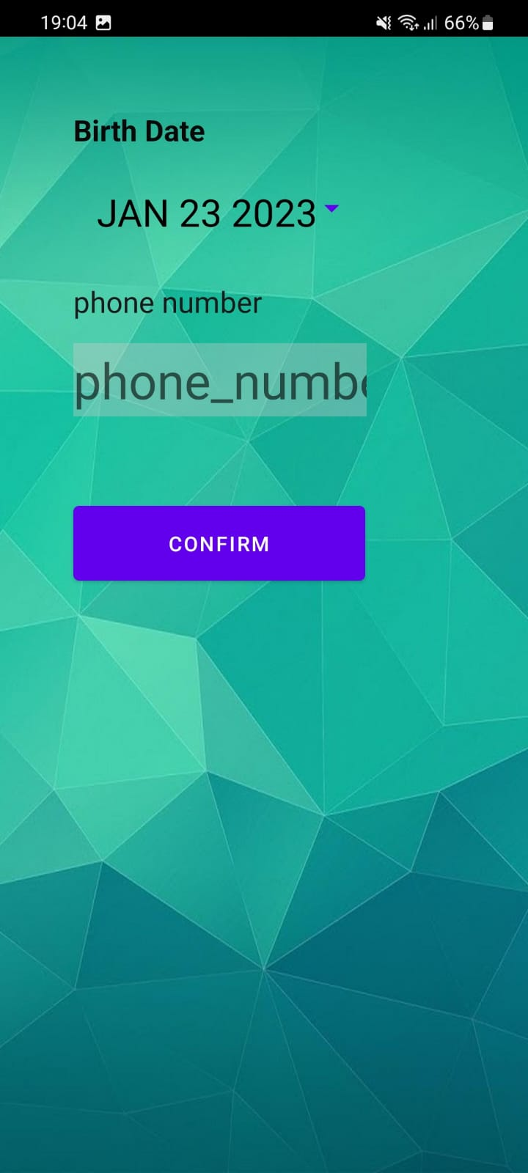
Problem solution
Our solution was to create a new activity
Which will complete the sign-up process for google accounts .
The user is asked in this activity to provide the missing information
(date of birth and phone number) after checking if the information is valid
we insert the user to the data base.

Slide 13
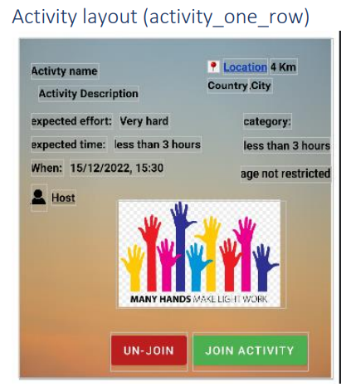
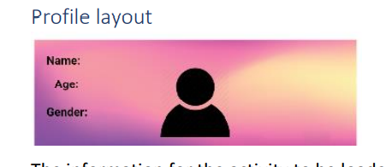
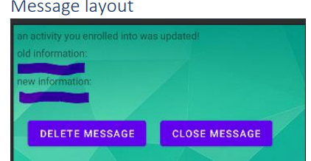
Inflate layouts
We decided to create 3 main layouts that could be inflated into another layout, and they will display an instance of the 3 different data structure we defined in our application :

Slide 14
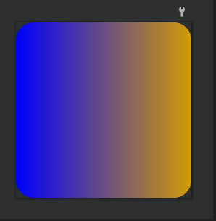
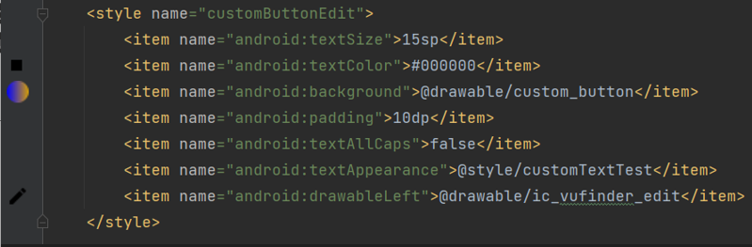
Custom buttons
We defined multiple themes to customize our buttons :
-design drawable shape (background of the button).
-imported and design icon for each button .
-we defined a theme for the button.
shape
theme

Slide 15
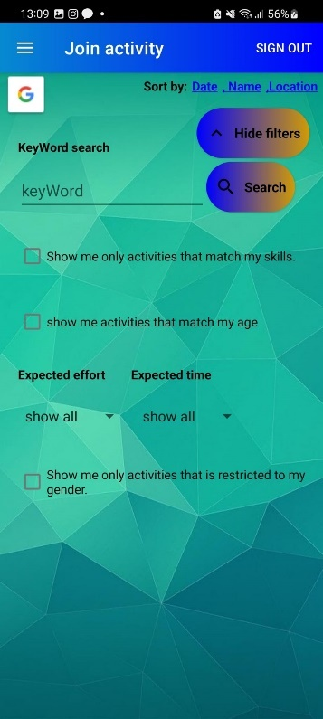
Filters
We have 2 types for filters :
1-filter based on the user provided information .
Skills , age , gender .
2-filter based on user input.
Text search, expected time/effort .

Slide 16
Google maps
Google map displays your current location, navigate location direction, search location etc. We can also customize Google map according to our requirement.
In our app we customized 3 different google maps instances :
Insert location
Show location in map
Map view
Current location is displayed and marked in the 3 instances .

Slide 17
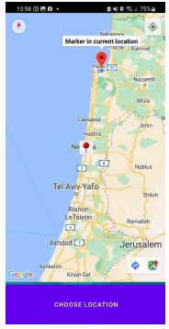
Google maps -Insert location
In our app we customized 3 different google maps instances :
Insert location
Show location in map
Map view
From create activity fragment we start the insert location activity for result (we wait until the maps activity is finished and use the picked location info).
Retrieved location info :
-longitude
-latitude
-Country Name
-City Name

Slide 18
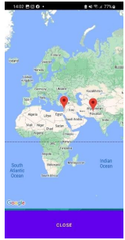
Google maps -Show location in map
In our app we customized 3 different google maps instances :
Insert location
Show location in map
Map view
From specific activity layout we start the show on map activity ,using intent we pass the required information to display the activity location in map :
-longitude
-latitude
-activity Name

Slide 19
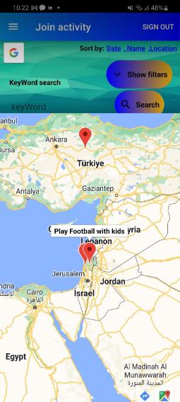
Google maps -Map view
In our app we customized 3 different google maps instances :
Insert location
Show location in map
Map view
Like show on map activity , we display all the activities that has a defined
location on map .
The main difference is that the map instance is hosted by the joined activity fragment
And we don’t need to pass data between fragments or activities.

Slide 20
Distance from current location
We asked for current location permission from the user , and if granted :-
We used the current location and the activity’s location to calculate the distance
Between them.
Sort by location: sort the activities map using Kotlin built in sort and display them to user.

Slide 21

Page viewer for activities
We split the displayed activities into pages and used page viewer to navigate between them .
Every page can view up to 4(constant) activities ,the reason
We did this is to not overload on the page, so the performance want
Be affected .

Slide 22
Fire Base-Fire Store
Cloud Firestore is a flexible, scalable database for mobile, web, and server development from Firebase and Google Cloud. It store the data in documents that organized in collection .
We have 2 main collections , in our project USERS and ACTIVITES .
When a new user sign up , we add a new document to the users collection.
When a user changes his information in his profile page , we update this user info in firestore .
When a new activity created , we add a new document to the activities collection.

Slide 23
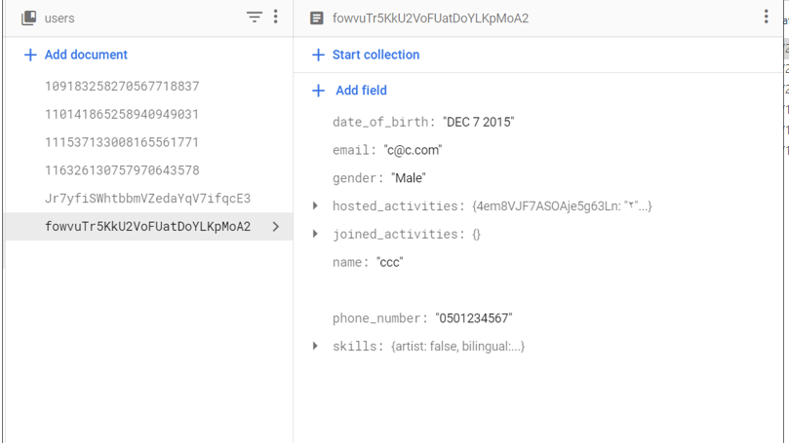
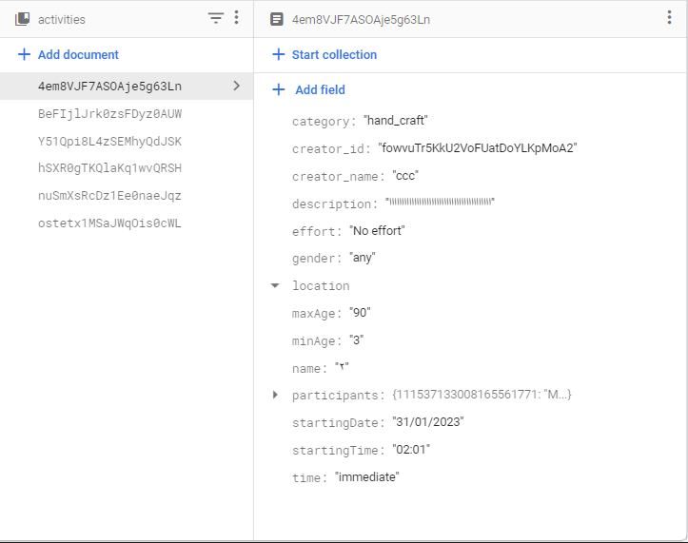
User
activity

Slide 24
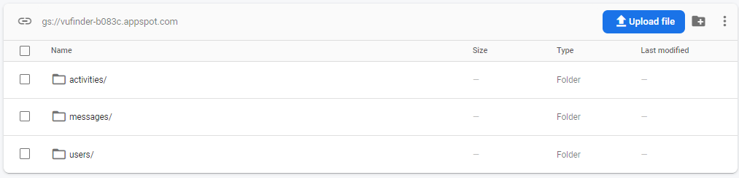
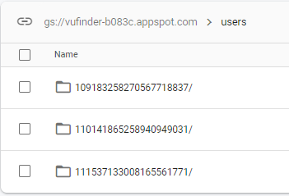
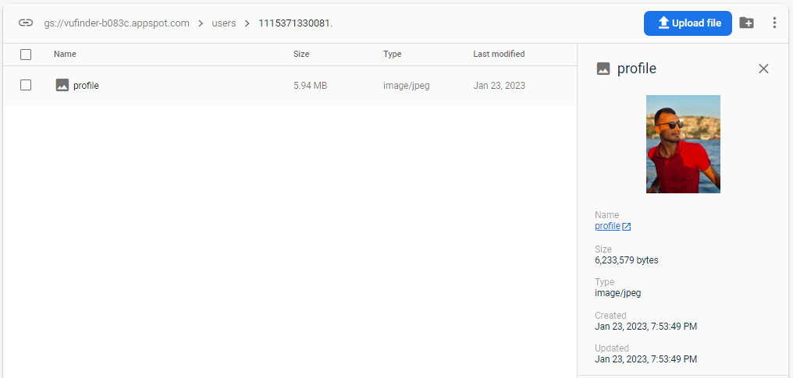
Firebase storage
Cloud Storage for Firebase is built for app developers who need to store and serve user-generated content, such as photos or videos.
Profile picture

Slide 25
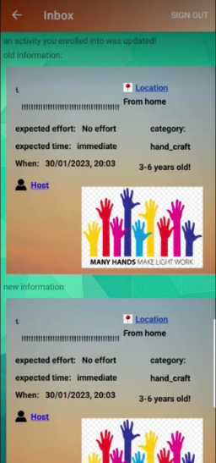
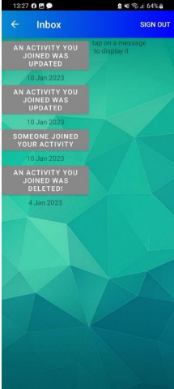
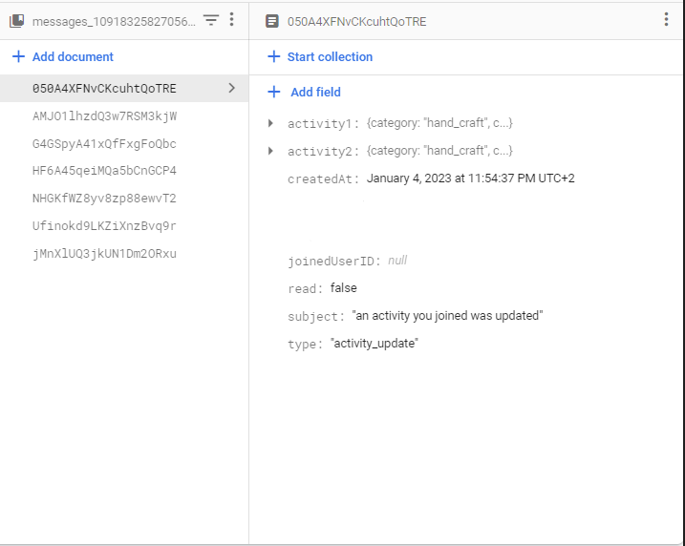
message
inbox
the notifications are loaded from the current user messages database. The unread messages are colored, and the read ones are grayed out.
We added a collection for each user that represents the received messages(notification) .
Each message saves up to 2 photos in the firebase storage , since the number of messages is much larger than users and activities, we compress this photos into low quality, so we don’t overload on the storage.

Slide 26
What we have learned ?
Learning Kotlin and using the Android Studio.
Learning how to use Firebase fire store and storage .
debugging an application on physical device and on emlator.
Designing an easy-to-use UI.

Slide 27


